Slide 1
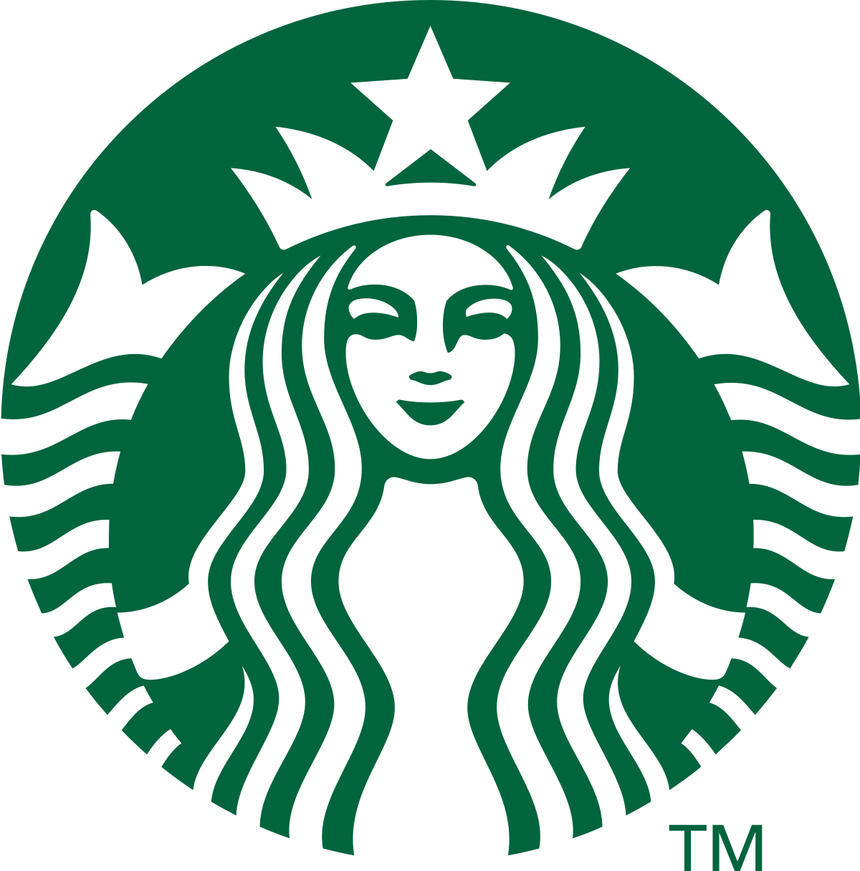
Starbucks in 2020: Striving for Operational Excellence and Innovation Agility

Slide 2
TEAM
Harshit
Apurva
Aashima
Yash
Dhairya
Jaideep

Slide 3
AGENDA
01
Company’s Overview
02
Vision
03
04
Competitive Strategy
Values
05
Policies
06
Issues & Recommendation

Slide 4
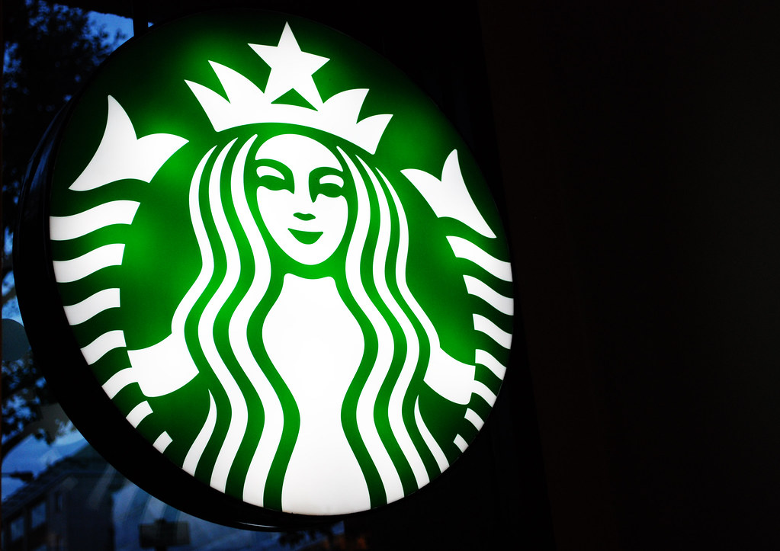
COMPANY’S OVERVIEW

Slide 5

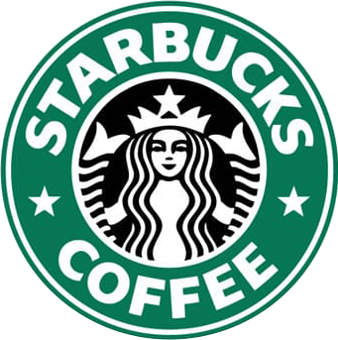
Company’s Overview
1971
1980
Present
Starbucks was founded in 1971 by Jerry Baldwin, Zev Siegl, and Gordon Bowker.
Opened their first Starbucks store in Seattle's Pike Place Market, by selling high-quality coffee beans and equipment.
By the early 1980s, the company had four Starbucks stores in the Seattle area
Worldwide the company became the premier “Roaster, Marketer, and Retailer of the speciality of coffees”.
Differentiating factor- “Top Quality, Fresh-Roasted, Whole-Bean Coffee” by rendering a plethora of options such as coffee, teas, sandwiches, wraps, desserts, wine, and beer.

Slide 6
VISION

Slide 7
Schultz Main Vision:
The vision that led to the success of Starbucks was the idea of creating a “Third place” for their customers. Schultz wanted to create a welcoming and pleasant place apart from the home and work, where people can enjoy some time relaxing and meeting their dear ones.
He believed in making Starbucks a national company with values and guiding principles that employees could be proud of.
Starbucks not only wanted this culture Nationally, but even internationally. Hence, starbucks started expanding their business out of USA. It opened 32,050 stores worldwide by March, 2020. In the markets outside the US, it had two expansion strategies: Company owned and operated stores, or license reputable and capable local companies.

Slide 8
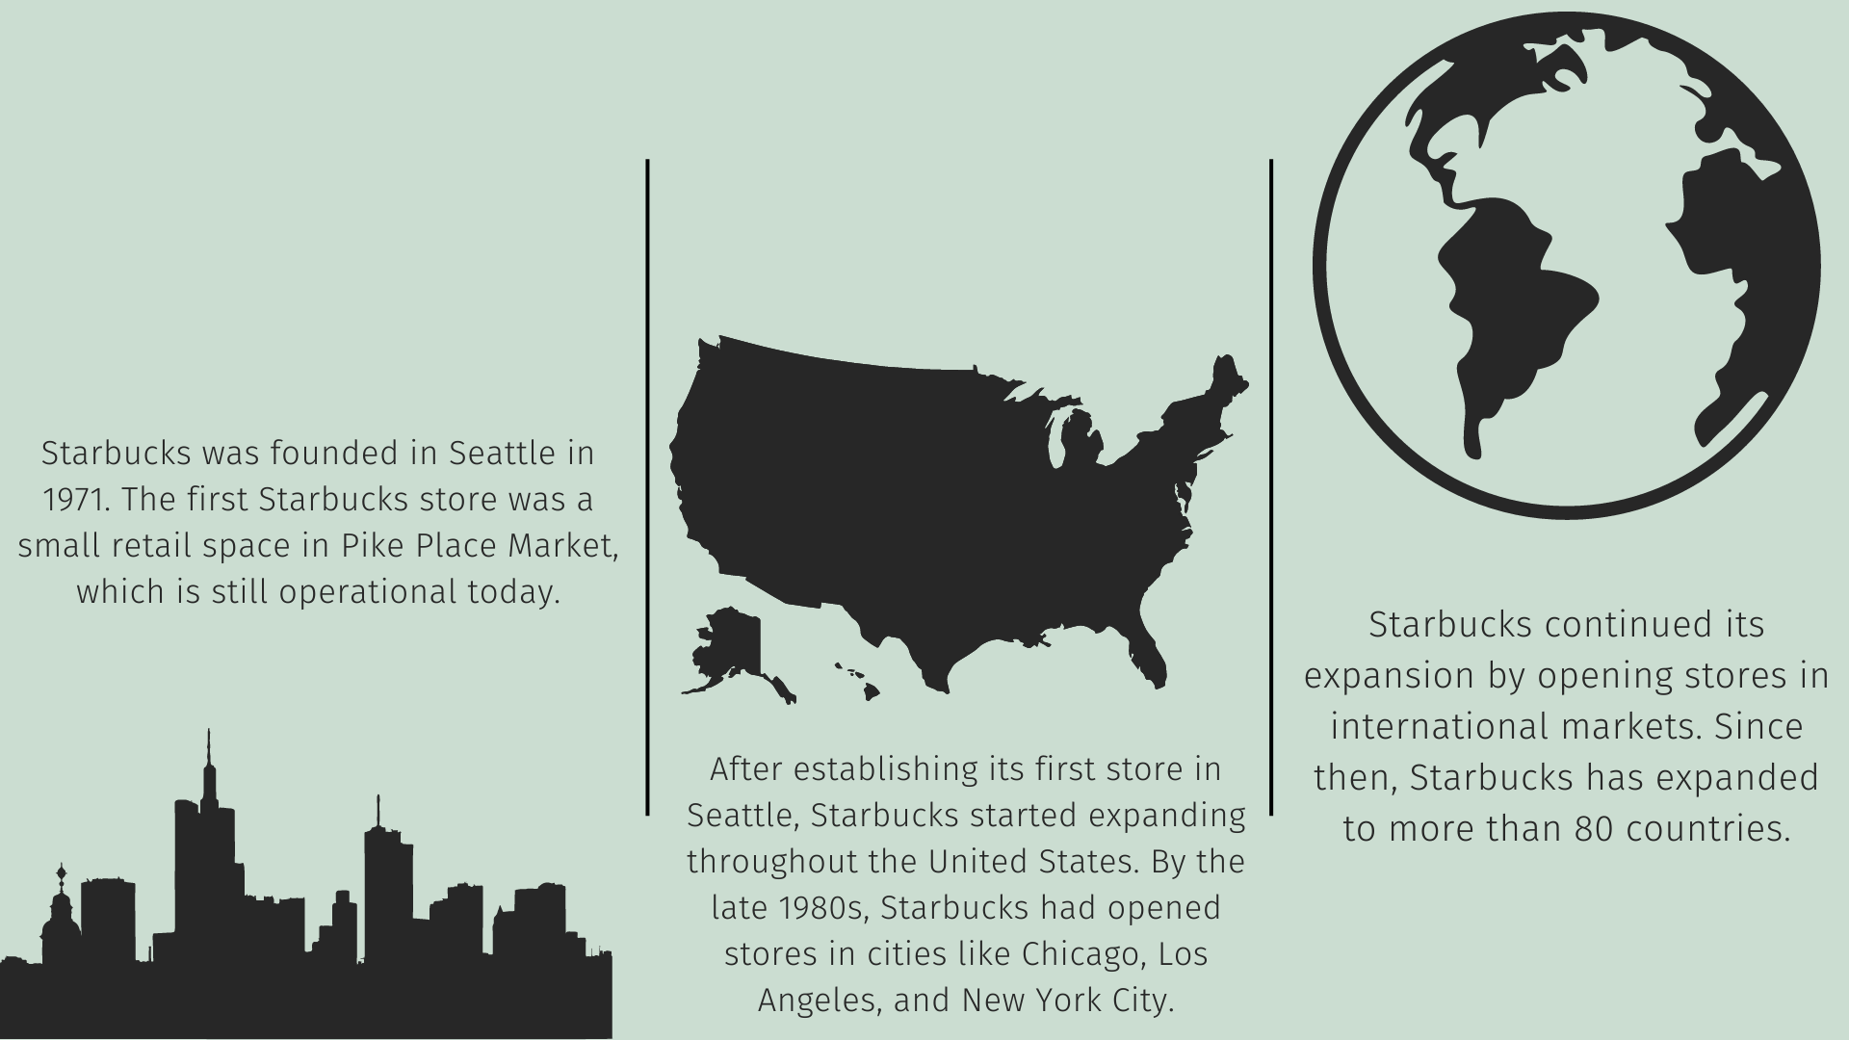
STARBUCKS EXPANSION

Slide 9
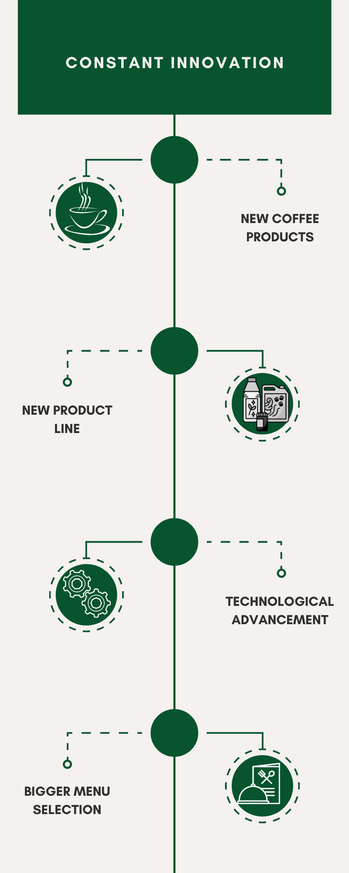
CONSTANT INNOVATION
CONSTANT INNOVATION
Entering new markets and product lines.
Partnership with SYSCO Corp., PepsiCo, Kraft, and US Foodservice for selling packaged coffee drinks, and their product Frappuccino being a hit with an annual sale of $2 Billion worldwide.
Starbucks also launched its coffee-flavoured ice cream with Dreyer’s Grand and then Unilever. They also didn’t leave a chance to enter the tea business by acquiring Tazo tea, followed by Teavana.
Starbucks showcased its “Early Adoption” nature by walking parallel to new technologies. With the introduction of the Starbucks card and then the Starbucks app, it evolved into one of the best retail loyalty programs.
Started bigger menu selections which included wholesome food and beverage options for people looking for something other than coffee. The menu included smoothies, juice, sandwiches and other options.

Slide 10
In 2017, Howard Schultz announced some initiatives and fresh approaches for company’s growth such as opening 20-30 Starbucks Reserve Roasteries and Tasting rooms, opening 1000 starbucks reserve stores to bring premium experiences to customers, and transform about 20% of company’s existing portfolio of starbucks stores into upgraded reserve coffee bars.
But, shortly after announcing, Schultz stepped down as a CEO and handed the role over to Kevin Johnson. Johnson revised and scaled back the sizes of Schultz’s visions due to their cost and unpredictable profitability. Hence, it is less likely for Johnson to continue with Schultz’s latest strategic vision and is more likely for him to follow the strategies that the company pursued before.

Slide 11
VALUES

Slide 12
Values
To create a comfortable and friendly environment for not only their customers but also for their employees
Creating a culture of warmth and belonging
Acting with courage, challenging the status quo
To be innovative and not afraid to take risks
VISION
We are performance-driven, through the lens of humanity
Achieving strong financial results while keeping in mind of its social and moral responsibilities
Being present, connecting with transparency, dignity, and respect
Values open communication and treating everyone with respect
STRATEGY
Delivering quality products and services
Strives to provide high-quality coffee and food products

Slide 13
COMPETITIVE STRATEGY

Slide 14
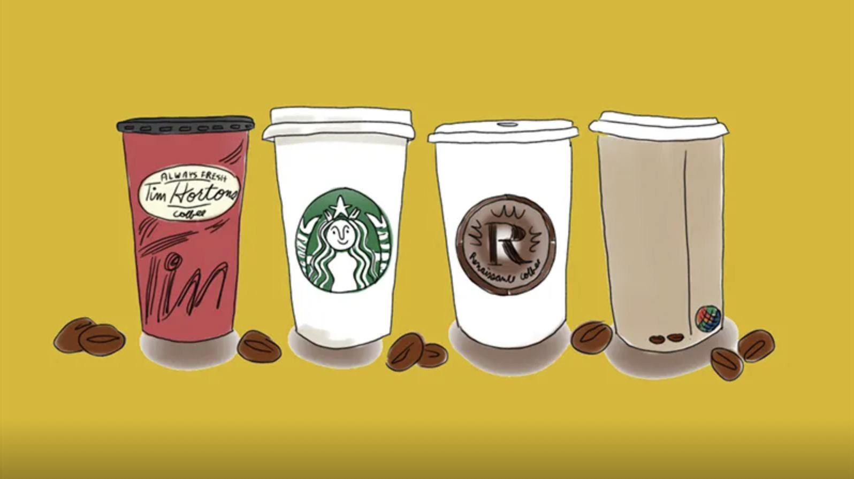
What makes Starbucks Stand-Out from its Competitors?

Slide 15
The company “Differentiates” under the following parameters:
Sourcing
Roasting
Preference Company-Owned Outlets/Licensing
Store Locations
Store Design and Ambience
Product Offerings
Unique Customer Service

Slide 16
Who are the Customers?
Coffee Lovers
Urban-ish, On the go
Professionals
Leisure
Hence, it can be concluded that the Starbucks Competitive Strategy is based on “Focused Differentiation Strategy”

Slide 17
KEY POLICIES

Slide 18

How do they Hire people? Starbucks’ success is heavily dependent on customers having a very positive experience in its stores
Who are Knowledgeable about the company’s product
Who pays attention to detail
Who can eagerly communicate Company’s passion for the product
Who possess the skills and personality to deliver consistent, pleasing Customer service

Slide 19
How do they Train?
Trainees
Receive at least 24 hours of training Covering coffee history, drink preparation, customer service, and retail skills
Experienced Managers and Baristas:
Sent to new store locations to lead store openings and provide one-on-one training.
Special Training Programs:
Offered for shift supervisors, assistant store managers, store managers, and district managers
Cover coffee knowledge, store operations , Information systems, and managing people
Learn beverage preparation
(grinding beans, steaming milk, pulling shots, memorizing recipes, and customizing drinks)

Slide 20
How do they Retain?
Starbucks’ Fringe Benefit Program for both part-timers and full-timers
Medical, dental, and vision coverage
Sick pay up to 40 hours per year
Paid vacations
Seven paid holidays
Personal day every six months
30% discount on purchases
Mental health and chemical dependency coverage
401(k) retirement savings plan with matching contribution
Short- and long-term disability
Stock purchase plan
Life insurance coverage
Accidental death and dismemberment insurance
Adoption assistance
Financial assistance program
Stock-Option Plan(Bean Stock)
Pre-tax payroll deductions for commuter expenses
Free coffee and tea products
In-store discount of 30%
Tuition reimbursement through Arizona State University
Gift-matching benefits
Starbucks believes if you treat your employees well, that is how they will treat customers

Slide 21
CHALLENGES

Slide 22
Challenges faced by Starbucks in 2020:
Luckin Coffee is a Chinese company with 3680 stores in 28 cities.
In its first year, Luckin Coffee generated $125 million in revenue but had a loss of $241.3 million.
Customer retention for Luckin Coffee is around 55%.
Luckin Coffee won a gold medal in the 2018 International Coffee Testing Championship.
Luckin Coffee offers special discounts, such as "Buy 2, get 1 free" on top of a 50% discount.
By the end of 2019, Luckin Coffee had more stores (4507) than Starbucks (4292) in China.
Starbucks and HeyTea are also competitors in the Chinese coffee market.

Slide 23
RECOMMENDATIONS

Slide 24
Recommendations to Kevin Johnson:
As of March 2020, Starbucks customers who placed delivery orders via the Uber Eats app were unable to receive Rewards credit for their orders.
Tackling competition from New Entrants
Recommendation: Reward credit benefits can certainly improve customer engagement and loyalty. Starbucks should consider adding Rewards credit points even for orders placed through third-party delivery partners.
Recommendation: To tackle new entrants like Luckin coffee and HeyTea, Starbucks should consider modifying or adding new items to its menus by researching the regional markets. For example, in the Chinese market, different varieties of tea can be introduced as it is a popular beverage in that market.

Slide 25
Community Stores around the world are inclusive of several store models
Focusing on innovation
Embrace sustainability
Starbucks should implement creative marketing and branding strategies that build Starbucks’s corporate image as a contributor to community development. Such an image can help reduce sociocultural opposition against the company’s expansion.
Starbucks should continue to invest in innovation. This could involve developing new products or services, trying out new store formats or technology, or engaging with customers in new ways.
Although Starbucks is already up to it, with rising environmental knowledge and concern among consumers, Kevin Johnson may want to give sustainability projects a priority to attract clients who value sustainability in their purchasing decisions.

Slide 26
Thank You!

